Slide 1
How to Test for Food Adulteration?

Slide 2
Milk
Water
Put a drop of milk on polished vertical surface. The drop of pure milk either stops or flows slowly leaving a white trail behind it. Whereas milk adulterated with water will flow immediately without leaving a mark.
Urea
Take 5 ml of milk in a test tube and add 2 drops of bromothymol blue soln. Development of blue colour after 10 minutes indicates presence of urea.

Slide 3
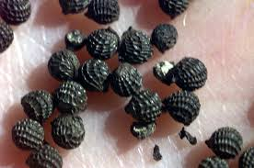
Mustard Seeds
Argemone Seeds
Argemone seeds have rough surface and mustard seeds on pressing is yellow inside while argemone seed is white.

Slide 4
Ice Cream
Washing Powder
Put some lemon juice, bubbles are observed on the presence of washing powder

Slide 5
Sugar
Chalk
Dissolve sugar in a glass of water, chalk will settle down at the bottom, similarly for salt

Slide 6
Silver Foil
Aluminium Foil
On ignition genuine silver foil burns away completely leaving glistening white spherical ball of the same mass while aluminum foil is reduced to ashes of black Grey colour.

Slide 7
Honey
Water
A cotton wick dipped in pure honey burns when ignited with a match stick. If adulterated presence of water will not allow the honey to burn, if it does will produce a cracking sound.

Slide 8
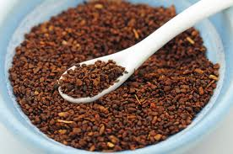
Coffee
Chicory
Gently sprinkle the coffee powder on surface of water in a glass. The coffee floats over the water but chicory begins to sink down within few seconds. The falling chicory powder particles leave behind them a trail of colour, due to large amount of caramel they contain
Chicory is a caffeine-free herb that was developed into a coffee product by the French during their civil war. It is now a popular beverage.

Slide 9
Tea
Colored leaves
Rub leaves on white paper, artificial color comes out on paper.
Used tea
Tea leaves sprinkled on wet filter paper. Pink or red spots on paper show color
Iron fillings
Move a magnet through the sample. Iron will stick to the magnet.

Slide 10
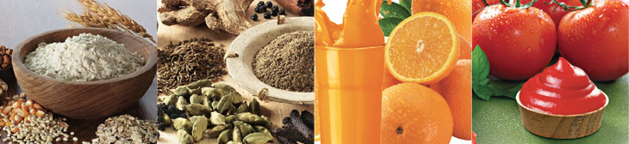
Common Food Adulterants
CEREALS
Small stones
Mud, straw, animal excreta
Ergot seeds
Inferior quality or infested food grains
Atta sold after removing gluten (a protein)
Iron Filings
DALS
Small stones, Mud, straw
Mixing inferior quality dal
Coating dal (yellow) with metanil yellow/lead chromatic to make it shiny.
Kesari dal to arhar and channa dal
Talcum powder to polish dals (especially urad and moong washed) to improve appearance.

Slide 11
Common Food Adulterants
EDIBLE OIL
Mixing inferior quality or less refined oil
Mixing inedibleoil with edible oil eg. mobil oil
Rancid oil sold as such or mixed with good quality oil
Oil from seed of prickly poppy (argemone) mixed with mustard oil
MILK
Water, at times unclean
Starch, blotting paper to thicken it
Removing cream and adding a little sugar
Skimmed milk powder and water
Mixing inferior quality butter, vanaspati after extracting cream

Slide 12
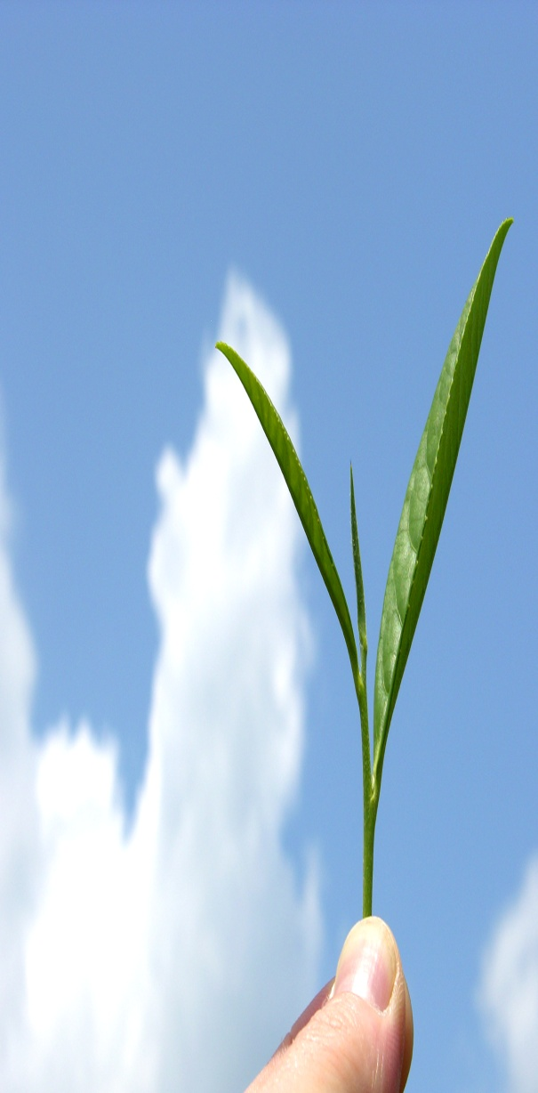
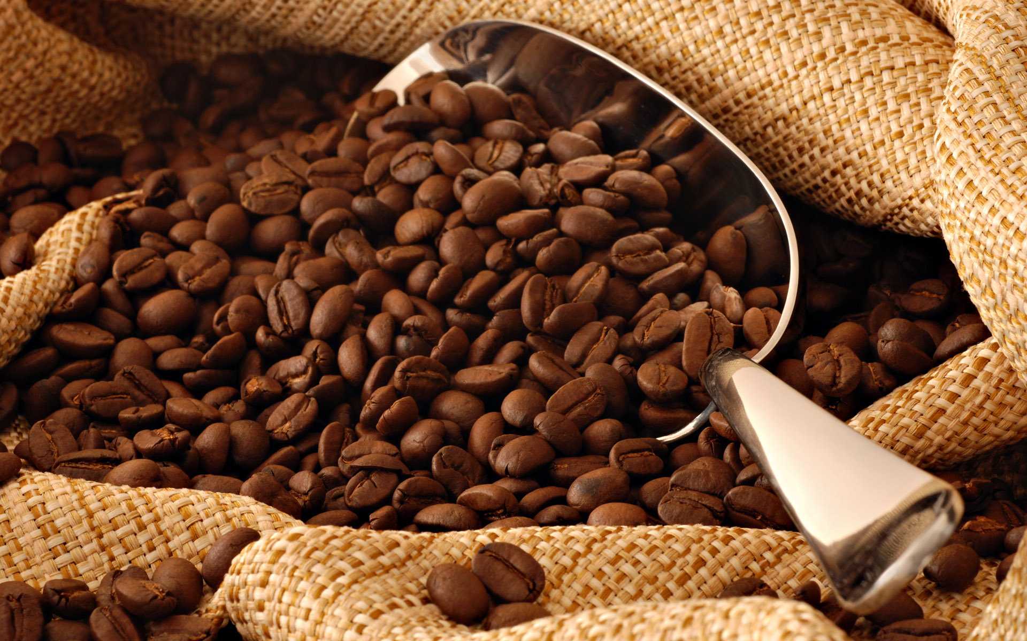

Adulterants We Daily Intake
TEA LEAVES
Inferior quality tea leaves
Used tea leaves, colored dried and mixed.
Leaves other than tea leaves
Iron filings
Outer coat of black dals like urad whole, powdered and added
COFFEE
Used coffee powder, colored and dried
Powder of inferior quality beans mixed
Mixing chicory without indicating on packet

Slide 13
Adulterants in SWEETS
Harmful color like metanil yellow and artificial sweeteners
Aluminum foil in place of silver foil
Blotting paper to thicken khoya
Adulterated food items like milk, maida, khoya etc.

Slide 14
Adulterants in SPICES
TURMERIC POWDER (HALDI)
Coating whole turmeric or mixing in the powder metanil yellow and lead chromate color
Maida, powdered rice, powdered dal-colored yellow and mixed
DHANIA POWDER & OTHER MASALAS
Mud
Sand
Straw
Saw Dust
Dried Dung
CHILLI POWDER
Saw Dust
Brick Powder
Artificial Color (red)
MUSTARD SEEDS
Argemone
BLACK PEPPER SEEDS
Dried Papaya Seeds

Slide 15
Red Chilli Powder
Rodamine Culture
Take 2gms sample in a test tube, add 5ml of acetone. Immediate appearance of red colour indicates presence of Rodamine.
Brick Powder
Brick powder settles fast chilli powder settles slowly when put in water.

Slide 16
Turmeric Powder
Metanil Yellow
Add a few drops of HCl to the extract of turmeric from water. Instant appearance of violet, when the colour persists when diluted with water indicates the presence of metanil yellow.

Slide 17
Maggi
LEAD
Percentage present is 17.5 PPM.
In kid food it should be less than 0.01 PPM
Consequences of LEAD in Kids body.
Kids absorbs LEAD quickly as compare to Adults.
It is stored in body
It is slow poison for body
It affect brain ,leaver, kidney and bone.
Slow down the digestion.
burns leaver cells
lead to Osteoporosis

Slide 18
Cadbury
2003 small insecticides was found in Cadbury Chocklet
In 2006 Delhi Center for science and environment found
some pesticides like dddt , malthoyan and clorapyriphos was found in popular brand like Pepsi, Cola , Mirinda, Limka.
The percentage was 30 more than the decided quantity by European Union.
Few more product of some popular brand
like Nestle, Haldiram, Macdonad, K FC was found harmful colors
over percentage of sugar and preservatives, oils was found in 2012 by Food Authority of India.[FDA]

Slide 19
Adulterants can cause you and your children serious consequences so be sure whatever you are eating is not adulterated. Want to be a part of fight against Adulteration and save your children from its consequences?

Slide 20
There are lot of more food products which are adulterated using different chemicals or materials.
Detection methods of Adulteration in those food products we will discuss in next .
We strongly Recommend that you just use Non-Adulterted and High Quality Food Products to keep you away from its serious consequences.

